Slide 1
Optical sources
Arpita howlader
Dept of Computer & Communication Engineering
Patuakhali Science and Technology University

Slide 2
Introduction
Optical sources are used to convert electrical signals into optic beams thus enables information carrying facility though the fiber core.
Two basic types which rely on semiconductor principles of operation are
Light emitting diodes (LEDs)
Laser diodes (LDs) (Light Amplification by Stimulated Emission of Radiation)
Generation of light is caused by the transition of an electron form an energetically higher energy state to a lower energy state.
The energy difference due to the transition of the electron leads to a radiative or a nonradiative process.
The non-radiative processes typically lead to the creating of heat.
In the case of a radiative process photons are emitted. The emission of light, can take place either spontaneously or it can be stimulated by the presence of another photon of the “right” energy .

Slide 3
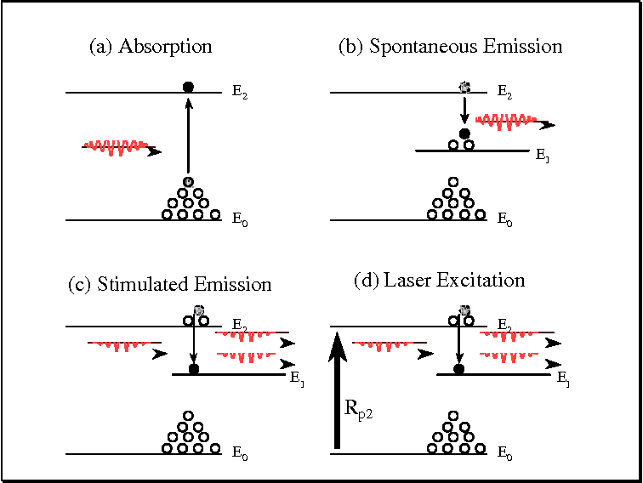
Characteristics of laser
Laser Light is Highly Coherent
Laser Light is Highly Monochromatic
Laser Light can be Sharply Focused:- This property is related to the parallelism of the laser beam.
Brightness:- The primary characteristic of laser radiation is that lasers have a higher brightness than any oilier light source.

Slide 4
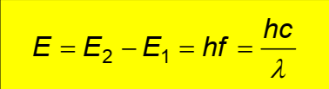
Absorption and Emission of light
The interaction of light and matter in the form of absorption and emission requires a transition from one discrete energy level to another energy level.
The frequency and the wavelength of the emitted or absorbed photon is related to the difference in energy E, between the two energetic states, where h is the Planck constant h=6.626 x 10-34J, f is the frequency and λ is wavelength of the absorbed or emitted light
When a photon with the energy (E2-E1) is incident on the material an electron may be excited from the energy state E1 into an higher energy state E2 through the absorption of the photon.
Alternatively, when the electron is initially on a higher energy level it can make a transition to a energetically lower state and the provided energy loss leads to the emission of a photon. Here the transition is assumed to be a radiative transition.
The amount of energy absorbed by the electron to move into a higher level is the same as the amount of energy released when returning to the original energy level.

Slide 5
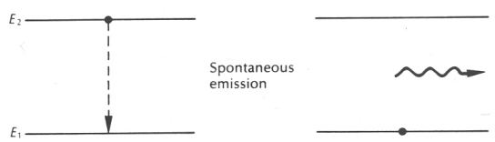
Spontaneous Emission
For most of the light sources the photons are emitted spontaneously (sun light, light bulb)
In a first step an electron is elevated to an energetically higher state which is usually unstable. In Second step the electron will spontaneously return to an energetically more stable (Lower) state
This process is a statistical process which can happen very fast. As a consequence the spontaneously emitted photons are incoherent and the emitted spectrum has broad spectral width. Energy state diagram for spontaneous emission of a photon.
Spontaneous emission occurs when an electron that is in an excited state spontaneously transitions to a lower energy state.
When this occurs, a photon is emitted. The energy of the photon is equal to the energy difference between the two energy levels.

Slide 6
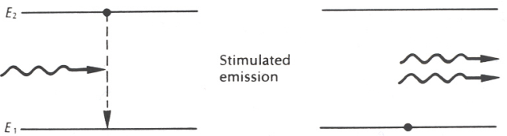
Stimulated Emission
The operating principle of a laser is based on stimulated emission.
stimulated emission, if the electron which enters an energetically higher state (excited state) remains in this state until it is “stimulated” by the presence of a photon to leave this higher energetically state and return to the more stable lower energetically state (ground state).
One of the requirements for stimulated emission is that the electron can stay in its excited state a relatively long period of time (a few microseconds) before it changes its state spontaneously.
In the case of spontaneous emission the electron stays in this excited state usually for a shorter period of time (picoseconds).
In the case of stimulated emission the electron can be “stimulated” by the presence of a photon to emit its energy in the form of another photon.

Slide 7
Emission
Stimulated emission is similar to spontaneous emission in that an electron moves from a higher energy level to a lower energy level, but these are two distinct processes.
Both the stimulating photon and released photon are emitted.
Spontaneous emission does not require an external electromagnetic stimulus to release energy, whereas stimulated emission does require external electromagnetic stimuli to release energy.
During spontaneous emission, only one energy wave is released, but during stimulated emission two energy waves are released.
In this case the energy of the incident photon has to be very close to the energy of the excited electron.
Stimulated emission takes place when the emitted photon has the same energy (the same wavelength), phase and direction as that of the photon which stimulated it!
Stimulated emission is the inverse process of absorption!

Slide 8
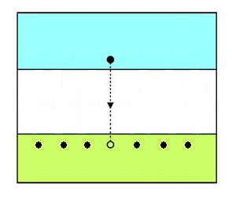
Laser Operation
The laser operation differs from other optical sources because of it is resulted from stimulated emissions. When external photon (injected photon) hits with the excited electron at the valence band, it is forced to create a stimulated photon and light is emitted with the same wavelength and the same line width as the external photon. They are also in phase.
Once these photons are travelled through the same direction, it will result
further stimulated emissions to support
the directionality of the beam.
This causes to deplete the conduction band
electrons very quickly, but generates a large
current to sustain the laser operation.
The number of spontaneous emissions are proportional to the number of injected photons
Conduction band
External photon
Stimulated photon
Valance band

Slide 9
Population Inversion
To sustain the laser operation, it requires more electrons in the excited state (conduction band) than the ground state.
Then only the stimulated emissions get higher than the stimulated absorptions
It is not possible to achieve population inversion with a 2-state system. If the radiation flux is made very large the probability of stimulated emission and absorption can be made far exceed the rate of spontaneous emission.
To create population inversion, a 3-state system is required. The energy level between the ground state E1 and exited state E3 is known as metastable state E2.
By optical pumping electrons from ground state jumps to exited state by absorbing photons. (10⁻⁸ sec)
The process of attaining a population inversion is called pumping.
The system is pumped with radiation of energy E3 then electrons in state 3 relax to state 2 non radioactively.

Slide 10
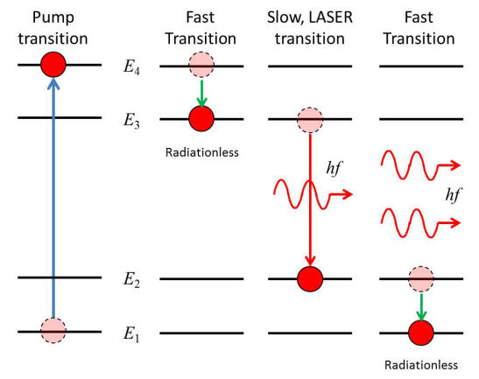
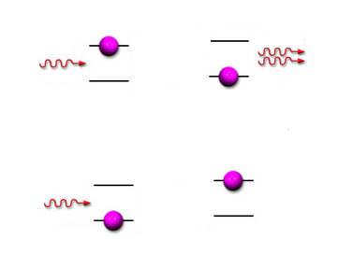
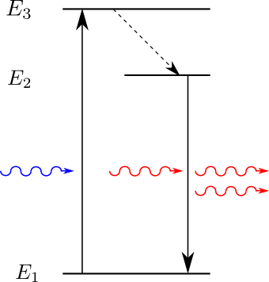
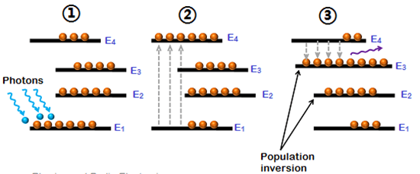
Population Inversion
(Before)
(After)
Conduction band
(Stimulated emission)
External photon
Valance band
Two photons
(Stimulated absorption)
Conduction band
Valance band

Slide 11
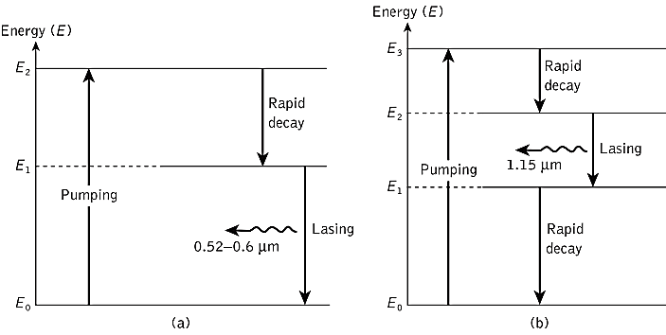
Population Inversion
Energy-level diagrams showing population inversion and lasing for two non-semiconductor lasers:
three-level system – ruby (crystal) laser;
four-level system – He–Ne (gas) laser

Slide 12
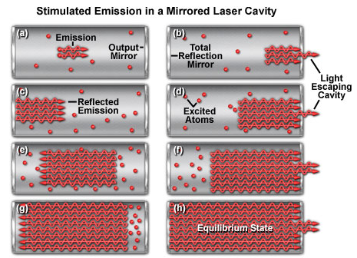
Amplification of Photons
Lasers themselves are large groups of photons focused into a beam
Stimulated emission works like an amplifier. If we take a system with a large amount of atoms that have electrons in high energy states, the electrons will want to come down from those states into a lower one.
Doing so emits a photon of a certain wavelength, depending on which energy state the electron began in and which state it dropped to.
In order to get an electron to drop from a high state to a low one, we can make it interact with an electromagnetic wave, or another photon!
Under the hood is a quantum process that
allows us to essentially put in one photon and
get two out of the exact same wavelength.
This is "stimulation" portion of Einstein‘s theory.
When another photon interacts with
the electron with a high energy atom,
the electron will drop and emit two photons.
This is our "emission". The entire process gives
us an amplification of photons that can be used
for our laser.

Slide 13
Application of laser
Medicine : Bloodless surgery, laser healing, surgical treatment, kidney stone treatment, eye treatment, dentistry, etc.
Industry : Cutting, welding, material heat treatment, marking parts.
Defense : Marking targets, guiding munitions, missile defense, electro-optical countermeasures (EOCM), alternative to radar.
Research : Spectroscopy, laser ablation, Laser annealing, laser scattering, laser interferometer, LIDAR (Light Detection And Ranging).
Product development : Laser printers, CDs, barcode scanners, thermometers, laser pointers, holograms, bubble grams.
Laser lighting displays : Laser light shows.
Laser skin procedures : such as acne treatment, cellulite reduction, and hair removal.

Slide 14
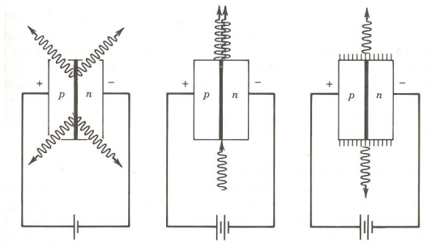
Light emitting diodes versus laser diodes
In order to observe spontaneous or stimulated emission we have to excite the electrons first before they can return to a lower energetic states.
Of course energy has to be provided to excite the electron. The energy can be provided by heat, absorption of photons (photoluminescence) or electrical current (electroluminescent).
We are interested in the later case, where the energy is provided by an electrical current.
In both types of devices the recombination of carrier is used to provide a photon flux.
However, the emission of light in a light emitting diode is a spontaneous process, whereas it is a stimulated process in a laser diode. Therefore, the description of an LED (light emitting diode) is different from the description of a laser diode.
In both cases a semiconductor diode is used, which operates under forward bias conditions. Furthermore, the same structure can be used to build an optical amplifier.
Forward biased pn-diode operating as
(a) LED
(b) semiconductor amplifier,
(c) semiconductor injection laser

Slide 15
Optical emission from semiconductors
To allow consideration of semiconductor optical sources it is necessary to review some of the properties of semiconductor materials, especially with regard to the p–n junction.
A perfect semiconductor crystal containing no impurities or lattice defects is said to be intrinsic.
Assume that the material has a perfect crystal structure, which means that the material has no structural defects (structural disorder) and they do no contain impurities.
The structural properties of Semiconductors have a strong effect on the electronic and the Optical properties of the material.
Semiconductors exist as crystalline or amorphous materials. Crystalline material exhibit a high degree of structural order, whereas amorphous materials are characterized by a random or partly random distribution of the atoms or molecules in the solid. We concentrate here only on crystalline materials.

Slide 16
Energy Bands in Semiconductors
The band structure of a single atom is characterized by allowed discrete energy levels. Electrons can stay on these energy levels.
When moving from a single atom to a solid several of these energy levels overlap and discrete energy bands are formed.
The band structure of semiconductor is characterized by a valence band and a conduction band. The two bands are separated by the band gap.
Each band is formed due to the splitting of one or more atomic energy levels.
To create an extrinsic semiconductor the material is doped with impurities which either create free electrons (donors) or free holes (acceptors).
When donor impurities are added to the material, the thermally excited electrons from the donor level are raised in the conduction band (negative charge) to create free carriers so semiconductor is said to be n-type.
When acceptor impurities are added, excited electrons are raised from the valence band to the acceptor impurity levels leaving an excess of positive charge carriers in the valence band and creating a p-type semiconductor where the majority carriers are holes.

Slide 17
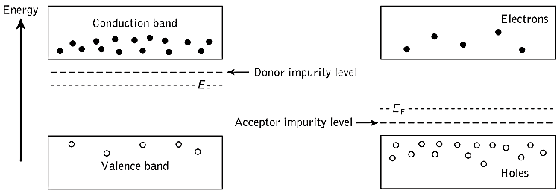
Energy Bands in Semiconductors

Slide 18
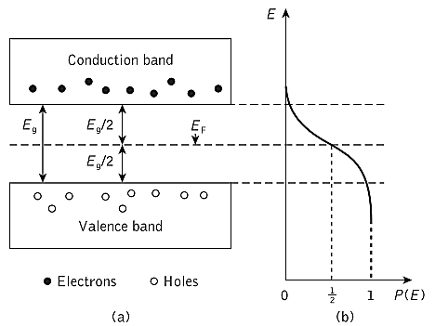
The pn-junction
A band structure for an intrinsic semiconductor is shown in the figure
(a) The energy band structure of an intrinsic semiconductor at a temperature above absolute zero, showing an equal number of electrons and holes in the conduction band and the valence band respectively
(b) The fact whether the conduction band is occupied by an electron is described by the Fermi-Dirac statistic. The Fermi Dirac function is a probability function.
Energy-level occupation is described by the Fermi–Dirac distribution function (rather than the Boltzmann).
Forward bias Vf applied fermi level of P down and N up

Slide 19


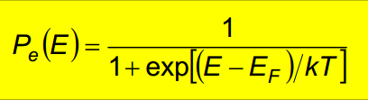
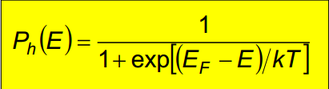
The pn-junction
The Fermi level is a measure of the distribution of carriers in the semiconductor.
Consequently, the probability P(E) that an electron gains sufficient thermal energy at an absolute temperature T, such that it will be found occupying a particular energy level E, where K= 1.381 × 10−23 is Boltzmann’s constant and EF is known as the Fermi energy or Fermi level.
The Fermi level can be seen as a probability function, which describes whether the bands are occupied or not.
The probability that a state is occupied by an electron or hole is exact 50% for the Fermi energy. Fermi-Dirac Distribution
Fermi-Dirac Distribution for Electrons Fermi-Dirac Distribution for Holes

Slide 20
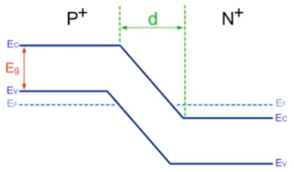
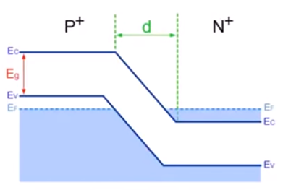
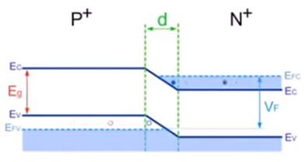
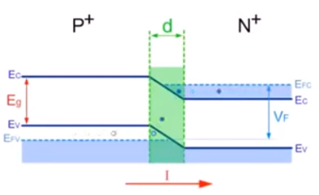
The pn-junction

Slide 21
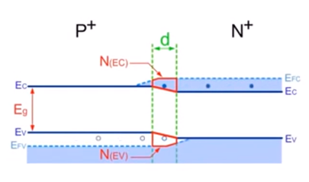
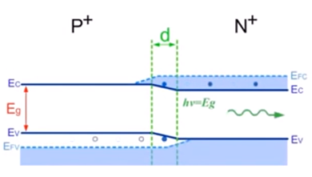
N(Ec) > N(Ev) , Population inversion satisfy

Slide 22
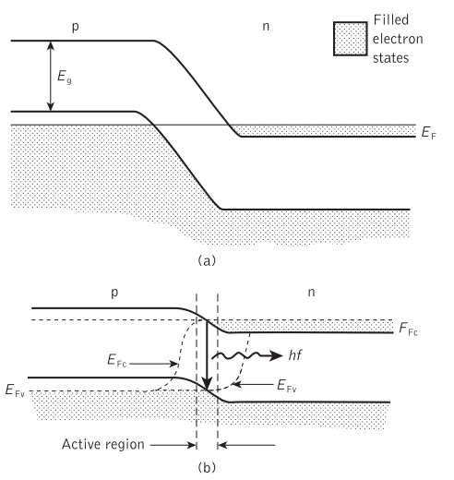
The degenerate p–n junction: (a) with no applied bias; (b) with strong forward bias such that the separation of the quasi-Fermi levels is higher than the electron–hole recombination energy hf in the narrow active region. Hence stimulated emission is obtained in this region

Slide 23
The pn-junction
A pn-junction is formed by creating adjoining p- and n-semiconductor. As a consequence a depletion layer is formed by the recombination of free carriers (a).
A potential barrier between the p- and n-type regions which restricts the inter-diffusion of majority carriers from their respective regions(b).
In the absence of an applied bias voltage no net current is flowing through the diode. The width of the depletion layer and the magnitude of the electric field (potential barrier) depends on the doping level in the p and n- type region .
If now a voltage is applied to the pn-junction the potential barrier is either increased or lowered.
For positive applied voltages the diode is forward biased and the potential barrier is lowered, whereas for negative voltages the diode is in reverse biased and the potential barrier is increased.
As a consequence the electric field in the depletion layer is increased or decreased. Electrons from the n-type region and holes from the p-type region can flow more readily across the junction into the opposite type region.
This situation in suitable semiconductor materials allows carrier recombination with the emission of light

Slide 24
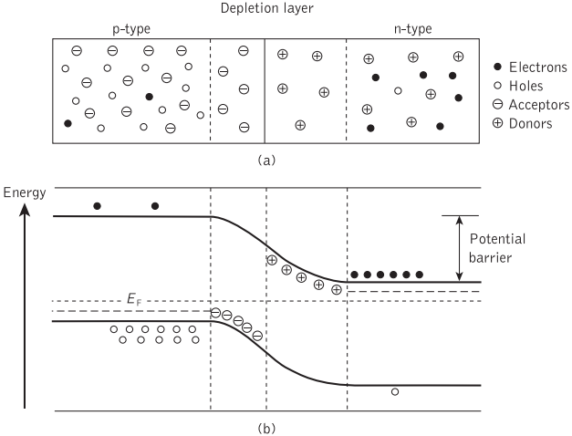
The pn-junction

Slide 25
Diodes under forward bias
Under forward bias conditions electrons and holes are injected in the semiconductor via the contacts. Electrons are injected via the n-type region and holes are injected via the p-tpye region.
Due to injection of carriers the concentration of minority carriers will increase in the vicinity of the depletion region. Electrons are minority carriers in an p-type semiconductor and holes are minority carriers in an n-type semiconductor.
The opposite of minority carriers are majority carriers. Therefore, electrons are majority carriers in an n-type semiconductor and holes are majority carriers in an p-type.
If we now increase the concentration of minority carriers in a semiconductor a lot of the carriers will recombine via the majority carriers in this material.
For example the concentration of electrons in the p-region of a pn-diode can be increased by a applying forward bias to the diode.
The concentration of minority carriers in the vicinity of the depletion region is increased due to the diffusion of carriers. Recombination can be radiative or non-radiative.
The p–n junction with forward bias giving spontaneous emission of photons.

Slide 26
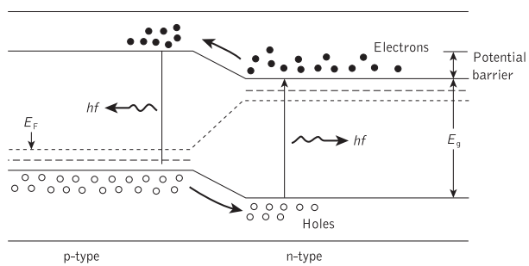
Diodes under forward bias

Slide 27
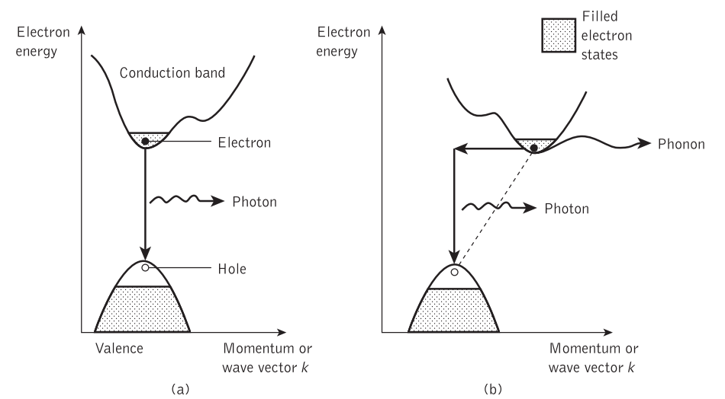
Direct and indirect band gap semiconductors
Typical examples of direct semiconductors are Gallium Arsenide (GaAs), indium phosphide (InP) or Gallium Nitride (GaN).
The most useful materials for this purpose are direct bandgap semiconductors in which electrons and holes on either side of the forbidden energy gap have the same value of crystal momentum and thus direct recombination is possible (a)
Hence when electron–hole recombination occurs the momentum of the electron remains virtually constant and the energy released, which corresponds to the bandgap energy Eg, may be emitted as light.
Typical materials for indirect semiconductors are silicon (Si) or germanium (Ge).
In indirect bandgap semiconductors, however, the maximum and minimum energies occur at different values of crystal momentum (b)
For electron–hole recombination to take place it is essential that the electron loses momentum such that it has a value of momentum corresponding to the maximum energy of the valence band. Recombination in indirect bandgap semiconductors is relatively slow.

Slide 28
Semiconductor materials
The semiconductor materials used for optical sources must broadly fulfill several criteria. These are as follows:
p–n junction formation. The materials must lend themselves to the formation of p–n junctions with suitable characteristics for carrier injection.
Efficient electroluminescence. The devices fabricated must have a high probability of radiative transitions and therefore a high internal quantum efficiency. Hence the materials utilized must be either direct bandgap semiconductors or indirect bandgap semiconductors with appropriate impurity centers.
Useful emission wavelength. The materials must emit light at a suitable wavelength to be utilized with current optical fibers and detectors (0.8 to 1.7 μm). Ideally, they should allow bandgap variation with appropriate doping and fabrication in order that emission at a desired specific wavelength may be achieved.

Slide 29
Semiconductor Injection Laser
Stimulated emission by the recombination of the injected carriers is encouraged in the semiconductor injection laser (also called the injection laser diode ) by the provision of an optical cavity in the crystal structure in order to provide the feedback of photons. The injection laser several major advantages over other semiconductor sources (e.g. LEDs) that may be used for optical communications. These are as follows:
High radiance due to the amplifying effect of stimulated emission. Injection lasers will generally supply mill-watts of optical output power.
Narrow line width on the order of 1 nm (10 Å) or less which is useful in minimizing the effects of material dispersion.
Modulation capabilities which at present extend up into the gigahertz range and will undoubtedly be improved upon.
Relative temporal coherence which is considered essential to allow heterodyne (coherent) detection in high-capacity systems, but at present is primarily of use in single-mode systems.
Good spatial coherence which allows the output to be focused by a lens into a spot which has a greater intensity than the dispersed unfocused emission.

Slide 30
Distributed Feedback Lasers
Used to generate signal with single frequency and Less susceptible to temperature variation
It has diffraction grating above active region and diffraction grating function as bragg reflector
Distributed Bragg diffraction grating provides periodic variation in refractive index
Feedback of optical energy is obtained through Bragg reflection rather than by the usual cleaved mirrors.
An optical Bragg grating is a transparent device with a periodic variation of the refractive index, so that a large reflectance (reflectivity) may be reached in some wavelength range (bandwidth) around a certain wavelength which fulfills the Bragg condition : The angle of incidence = angle of scattering.
single-frequency operation of (a) the distributed feedback (DFB) laser in comparison with (b) the Fabry–Pérot laser

Slide 31
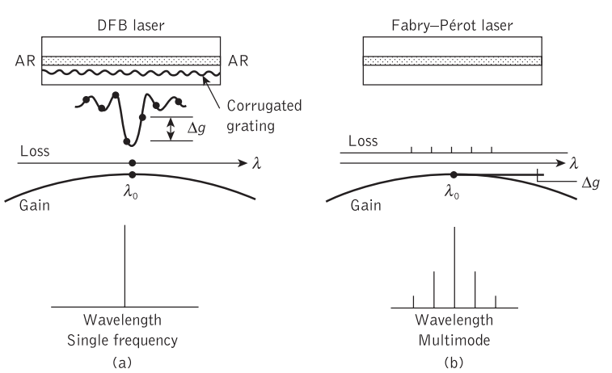
Distributed Feedback Lasers

Slide 32
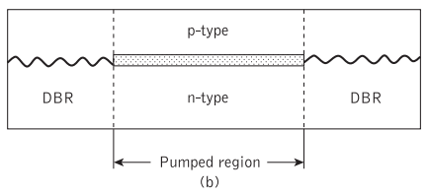
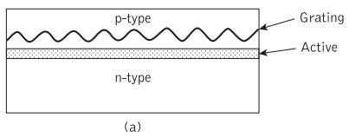
Distributed Feedback Lasers
When the period of the corrugation is equal to lλB/2ne, where l is the integer order of the grating, λB is the Bragg wavelength and ne is the effective refractive index of the waveguide, then only the mode near the Bragg wavelength λB is reflected constructively .
Figure (a), particular mode will lase while the other modes exhibiting higher losses are suppressed from oscillation
It should be noted that first-order gratings (i.e. l = 1) provide the strongest coupling within the device.
From the viewpoint of device operation, semiconductor lasers employing the distributed feedback mechanism can be said,
(a) Distributed feedback (DFB) laser
(b) Distributed Bragg reflector (DBR) laser

Slide 33
Distributed Feedback Lasers
A distributed feedback laser replaces the back mirror with a grating along the Cavity axis.
since the light is being reflected by the grating the reflected light is always in the correct phase no matter if it was reflected from the front or back of the grating.
The distributed nature of the Reflection sharpens the cavity resonance and distributed feedback lasers are typically of much narrower Bandwidth than the same laser with mirrors.
In the DFB laser the optical grating is usually applied above the entire active region which is pumped.
DBR laser the grating is etched only near the cavity ends and hence distributed feedback does not occur in the central active region.
Both DBR and DFB lasers are used to provide single-frequency semiconductor optical sources.
The DBR uses a high index contrast, high reflectivity surface grating. The DFB uses a low index contrast, low reflectivity buried grating.
In the case of a fiber laser, the distributed reflection occurs in a fiber Bragg grating, typically with a length of a few millimeters or centimeters.

Slide 34
THANKS
END

